Slide 1
Learning to Localize Sound Source in Visual Scenes
Arda Senocak, Tae-Hyun Oh, Junsik Kim, Ming-Hsuan Yang, In So Kweon. Senocak, Proceedings of the IEEE Conference on Computer Vision and Pattern Recognition. 2018.
발표자 : 에너지AI 트랙 김소희

Slide 2
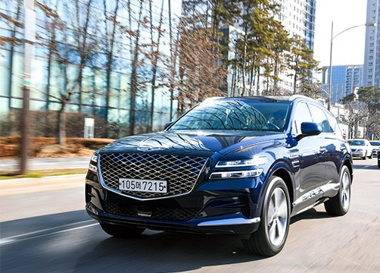
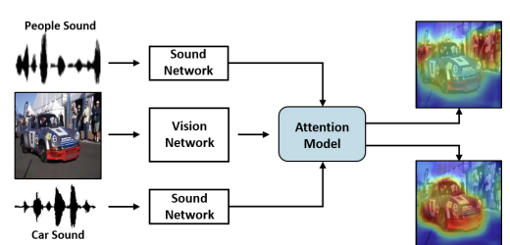
Learning to Localize Sound Source in Visual Scenes
1/13
Introduction
Learning based sound source localization
Human
Car → engine sound
How to learn to localize the sources (objects) from the sound signals
Notes:
When we see that car is moving, we hear the engine sound at the same time.
As shown in example, the engine sound suggests where the source may be in the physical world.
Human unconsciously learn the correlation between visual – audio examples from their whole life. Human can understand and localize the sound source even without seperate education.
In this photo, we can localize sound sources naturally, that means we know where the engine sound come from without any education.
Naturally, videos and their corresponding sounds also occur together in a synchronized way.
The question “Can a machine learning model learn to associate the sound with the visual scene to reveal the sound source location without any supervision similar to human perception?” was a motivation of their work.
So, in this paper, they model the spatial correspondence between visual and audio information by leveraging the correlation between the modalities based on simply watching and listening to videos in unsupervised way, called learning based sound source localization

Slide 3
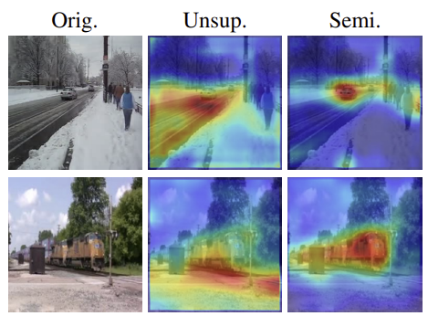
Learning to Localize Sound Source in Visual Scenes
Introduction
Learning task from unlabeled data = challenging
Unconstrained video contains
unrelated audio
audio source that is off the screen
Pigeon superstition
Biases the resulting localization to be unmatched
Semi-supervised setting
Provide some prior knowledge
Add supervised loss
Annotated data
Notes:
The learning task for sound source localization from listening is challenging, especially from unlabeled data. Unconstrained videos are likely to contain unrelated audio to the visual contents or audio source that is off the screen, e.g., narration, commenting, etc
Another challenge is a classical phenomenon in learning theory, pigeon superstition.
It is an experiment about delivering food to hungry pigeons in a cage at regular time. Pigeons believe that their specific action make food arrive, reinforced to do a specific action. Such self-reinforcement occurs regardless of trueness of causality of the event and its chance.
Some of such fundamental issues that naturally occur in the context of animal learning also appear in machine learning.
These biases the resulting localization to be semantically unmatched, in some examples.
Unsupervised are difficult to disambiguate the sound sources without certain amount of supervision, as the picture show.
They correct this issue by semi-supervised setting, pri
They annotate a new sound source localization dataset. Their dataset is the first to address the problem of learning based sound localization.

Slide 4
Learning to Localize Sound Source in Visual Scenes
Introduction
The main contributions
A learning framework to localize sound source using the attention mechanism, guided by sound information
A unified end-to-end deep convolutional neural network architecture
unsupervised, semi-supervised, fully-supervised
Collect and annotate a new sound source localization dataset
Notes:
We introduce a learning framework to localize sound source using the attention mechanism, which is guided by sound information, with a paired sound and video frame. Thus, the sound source localization can be interactive with given sound input.
We propose a unified end-to-end deep convolutional neural network architecture that accommodates unsupervised, semi-supervised, and fully-supervised learning.
We collect and annotate a new sound source localization dataset, which provides supervised information and facilitates quantitative and qualitative analysis.

Slide 5
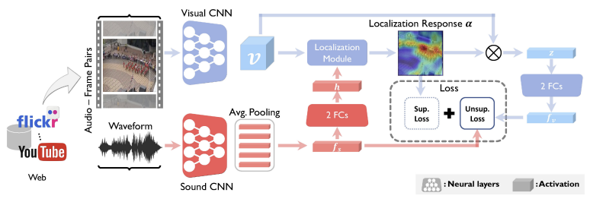
Learning to Localize Sound Source in Visual Scenes
Introduction
Notes:
They designed model by using 2 stream network architecture (sound and visual network).
It is designed to tackle the problem of sound source localization with unsupervised learning. The network uses frame and sound pairs to learn to localize the sound source.
I will explain more about architecture later.

Slide 6
Learning to Localize Sound Source in Visual Scenes
Introduction

